Slide 1

Retail Storyboard Review Document
© 1999, PricewaterhouseCoopers L.L.P.

Slide 2
Agenda
Project Scope and Approach
BroadVision Philosophy
Key BV Software Concepts
Demo Overview
Handouts
Goals/Objectives
Project Overview
1:1 Marketing
Customer Segmentation
Personalization
Rules
Templates
Features
Sample Storyboard Deliverables
Site Map
Scenario Summaries
Storyboard Scripts
Templates
Content Elements
Merchandise Hierarchy

Slide 3
PwC’s Retail Industry Practice has these goals/
objectives for our Broadvision Initiative
Project Scope & Approach
One Effort, Worldwide Usability
  Use at the Zone and at Retail Solution Centre
  Leverage JCP Content
  Subsequently provide a jump start for client projects
    Define client project methodologies including milestones, deliverables, toolsets
    Use as starting point for further template development
Demonstrate Industry Expertise - impact of B2C on brick-and-mortar
  Storyboard should provide opportunities to demonstrate our knowledge of industry issues (our value-added) and our “.com in a box” solution
  Targeting E-tailers who are Retailers (seeking solutions to e-tail and to multi-channel challenges)
  Provide relevance for anyone who wants to expand into B2C
Build in opportunity to expand the story to include other solutions in the future
  Necessary for RSC (e.g., SAP Retail integration)
  Great potential for more (e.g., B2B, Customer Information, etc.)
  Will simulate interfaces in Phase I
Highlight our understanding of and proposed solution for key challenges
  Global
  Multi-Channel
  B2C
  Personalization/CRM

Slide 4
We will achieve these using a three-phase strategy
which supports RSC development efforts
Project Scope & Approach
1
Develop a BV demo plan with a Point-of-View
2
Implement/Connect BV and other key apps for demo
3
Provide BV/PwC perspective on a “complete solution”
Retail e-Business Point-of-View Discussion Document
System Functionality
Storyboards, Content, Rules, Attributes
Potential Application Footprints
Integration with Net Perceptions & other packages
White papers, project accelerators
Supply Chain Integration Storyboards
Currently Phase 1 is partially complete and Phase 2 is about to begin

Slide 5
During the January and February, we will be working
to complete Phases 1 & 2 needed for demonstration
Project Scope & Approach
1
Develop a BV demo plan with a Point-of-View
2
Implement/Connect BV and other key apps for demo
3
Provide BV/PwC perspective on a “complete solution”
Completed Deliverables:
Storyboard Scenarios and Templates for 1,2,3
Key To-Be-Completed Deliverables:
Storyboard Scenarios and Templates for 4
Retail e-Business Point-of-View Discussion Document
Finalize Content, Rules, Attributes, Hierarchy, Communities*
Key Deliverables:
Potential Application Footprints*
Integration with Net Perceptions & other packages*
QA of RSC development*
Additional “thoughtware” to support RSC setup*
Content Delivery*
Key Deliverables:
White papers, project accelerators and guidelines
Supply Chain Integration Storyboards (connect to other CPG demos)
After February:
Replace simulated integration with real integration
Develop tools to support client implementations
* To be completed in conjunction with RSC efforts

Slide 6
Customer Segments and Community Development
BroadVision Philosophy
T&K communities are based on behavioral segmentation. Full-range shoppers represent the most important “community”, and can be considered the “default” community for unknown users:
Sale/coupon driven
Other
visitors
1%
High-end,
7%
luxury/brand-focused
customers
12%
(Scenario 2)
People who shop for
basics regularly
15%
(Scenario 3)
Full-range value shoppers /
Unknown Customer
65%
(Scenario 1)
Note: All data are hypothetical

Slide 7
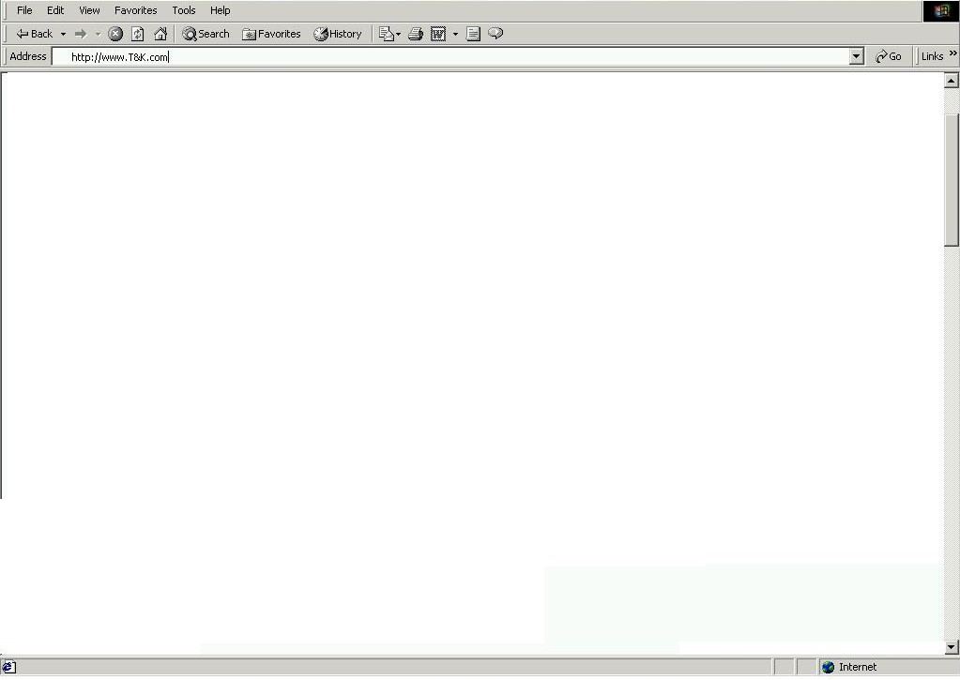

BroadVision Rules and Templates
BroadVision Philosophy
Personalization Template Samples
Homepage
Category / Sub-category Page
Specialty Shop Page
Product Detail Page
Shopping Cart
Homepage Rule Set Samples
Banner Ad Ruleset (BA_A)
Featured Product Rule sets
(FP_A, FP_B, FP_C, FP_D)
Ad Rule Sets (AD_A, AD_B, AD_C)
Incentive rule set (IN_A)
Matching Techniques for each Rule Set
Community rules
Purchasing History rules
Observation / in-session rules
Taxonomy matched rules
Sample Homepage Template and Content Zones
BA_A
FP_A
FP_B
AD_A
AD_B
FP_C
FP_D
AD_C
IN_A

Slide 8
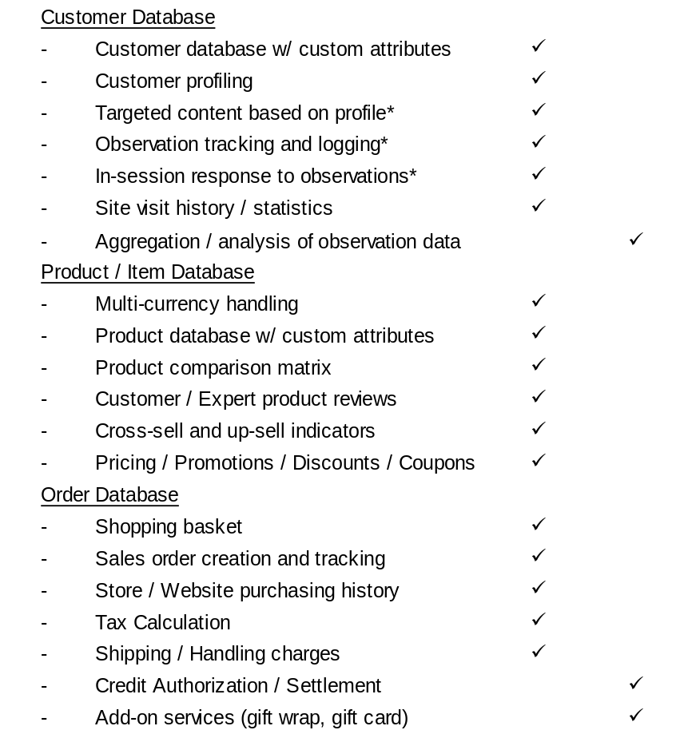
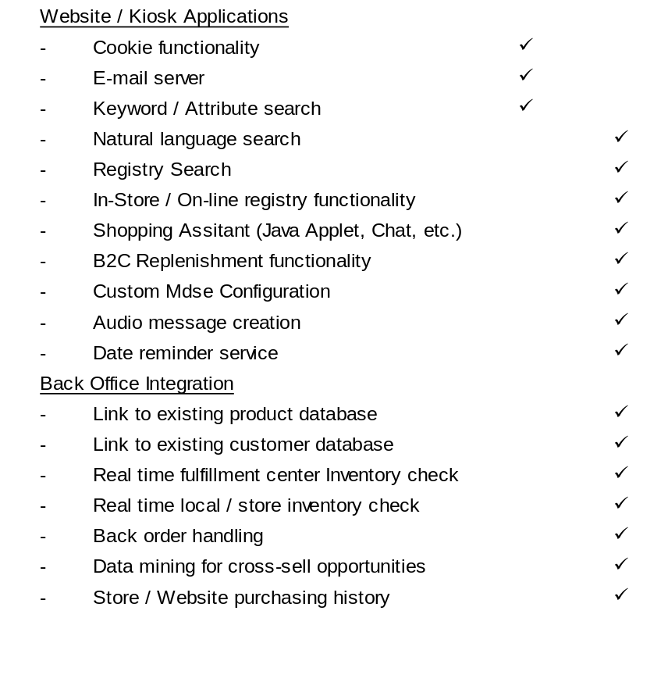
Demonstration System and Website Features
Key BV Software Concepts
BV
Feature
Custom
Feature
BV
Feature
Custom
Feature
System / Website Functionality
System / Website Functionality
* Net Perceptions functionality for these features to be determined

Slide 9
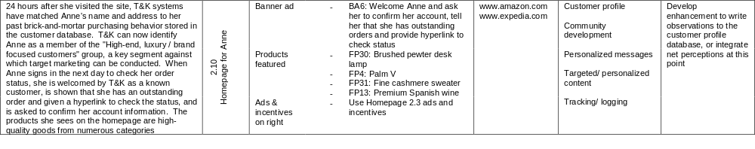
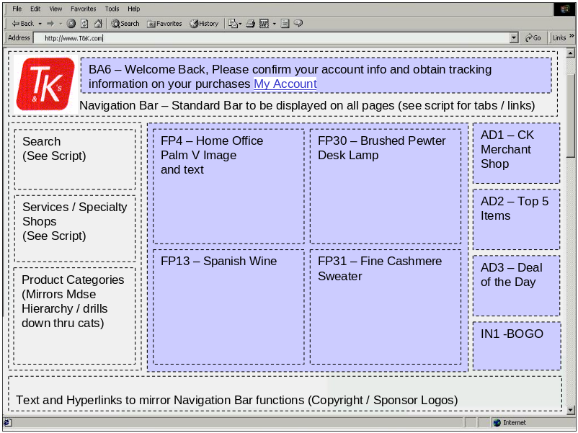
BroadVision Storyboard Documentation Example
Demo Overview
Storyboard Script
Customer Storyboard Slide Slide Elements Example Website BroadVision Features Custom / Enhancement
Webpage Example Slide 2.10

Slide 10
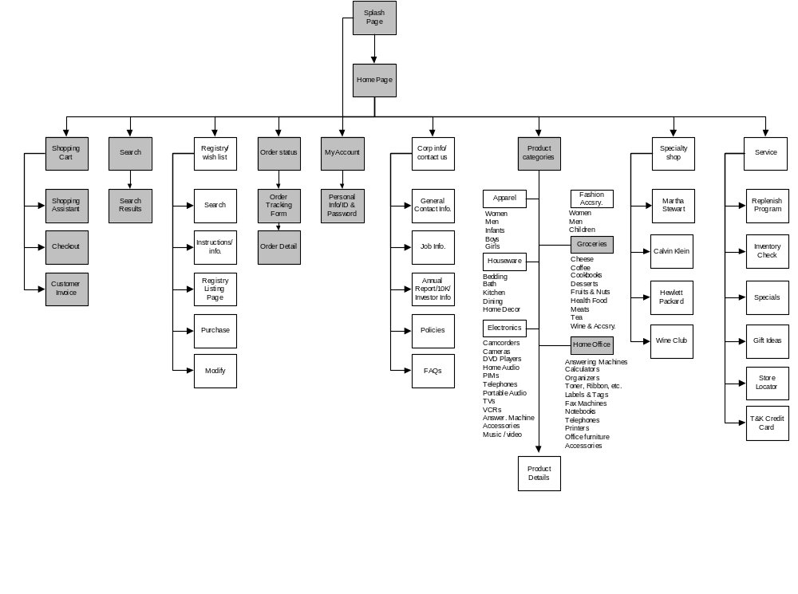
T&K Site Map
Demo Overview
Shaded boxes indicate webpages / functional areas that would be required to meet the minimum requirements for a working demonstration

Slide 11
T&K Demonstration Scenario Overviews
Demo Overview
Scenario 1: Unregistered user makes a registry purchase
An unregistered customer searches the T&K registry database to find a registry originally created in the UK. Selects an item from the registry, checks DC and local inventory, has his purchase gift wrapped and indicates that the gift will be picked up locally by the gift recipient. During checkout, he provides his purchasing information, creates an electronic gift card including a recorded voice message, and receives an e-mail confirmation of his purchase.
Scenario 2: Registered high end, brand-focused user builds profile and shopping history
A new user creates a T&K on-line profile, and shops for a printer using the product comparison matrix. She is offered complementary items and up-sell opportunities for more feature rich printers. After completing her first on-line purchase, the system recognizes her as an in-store customer by cross referencing her in the existing customer database and is able to develop a more complete picture of her shopping behavior. On return visits she is given increasingly personalized content based on her profile.
Scenario 3: Frequent basics customer responds to replenishment and cross selling
A T&K value card shopper enters his membership number, is recognized in the legacy customer database, and based on the web profile and purchasing history that is built is offered the opportunity to receive in home replenishment of items purchased most often. The customer also responds to cross sell advertisements and orders a custom configured CD compilation from T&K online.
Scenario 4: The T&K Product Manager / Merchant
The Product Manager utilizes reporting and analysis tools to better merchandise the website and respond to customer preferences

Slide 12
BroadVision Storyboard Handouts
Handouts
Scenario 1 – Script and Templates
Scenario 2 – Script and Templates
Scenario 3 – Script and Templates
Scenario 4 – Script
Content List of Template Data Elements
Merchandise Hierarchy

